Slide 1

DEVELOP AN APPLICATION THAT
DISPLAYS THE UV INDEX BASED ON DATA FROM UV-MEASURING PHONE CASES
DEVELOP AN APPLICATION THAT DISPLAYS BASED ON DATA FROM UV-MEASURING PHONE CASES
AUTHORS:
AFFILIATIONS:
TEAM INFORMATION
Trần Lê Quốc Thống
Đỗ Minh Duy
Phạm Thanh Thùy
Nguyễn Lê Mạnh Phi
Trần Gia Hiển
Phạm Thanh Phong
Nguyễn Huỳnh Tâm
EMAIL: 22130171@student.hcmus.edu.vn; 22130032@student.hcmus.edu.vn; pththuy@hcmus.edu.vn
Ho Chi Minh City, June 8th, 2025

Slide 2

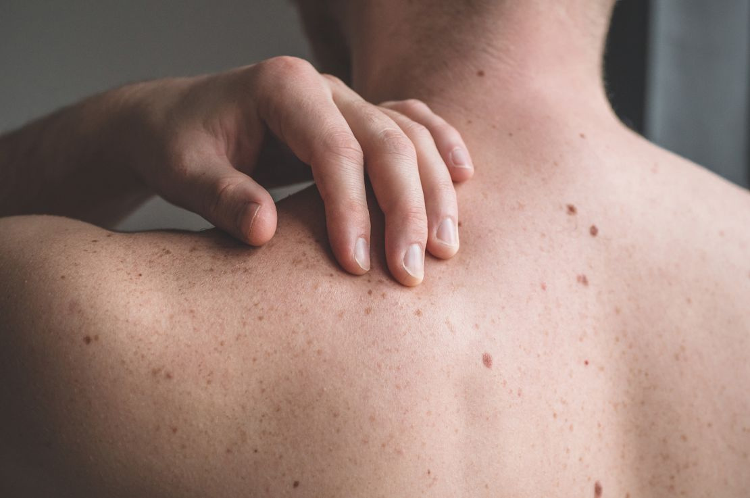
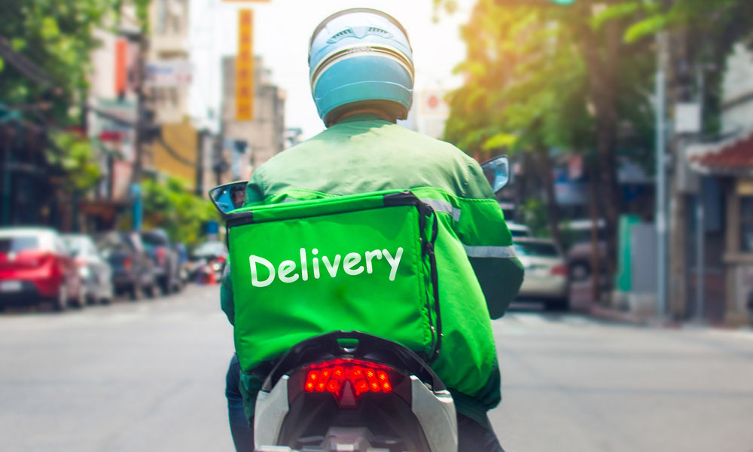
OVERVIEW
UV radiation from the sun causes
over 15 million skin cancers in 10
years.(according to WHO).
In addition, over 35% Vietnamese work outdoor - over 5 hours. (according to statistics from the Vietnam’s Ministry of Labor).

Slide 3
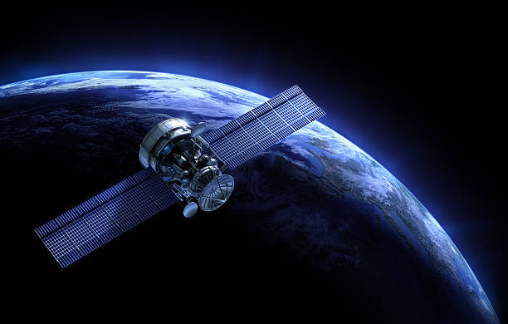
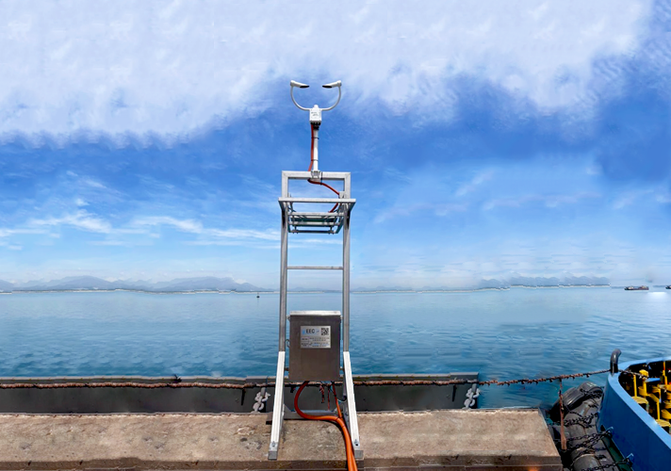
OVERVIEW
Satellite-derived UV data does not provide precise ground-level measurements.
Ground monitoring stations have high costs, limited coverage, require regular maintenance, and are often sparse in number.

Slide 4
OVERVIEW
SO HOW DOES “PHO BROTH” ADDRESS THIS ISSUE?

Slide 5

WHAT IS UVITA?
Mobile app providing real-time UV index data
Uses UV-sensing phone cases for accurate measurements
Helps users track sun exposure
Prevents skin damage and reduces skin cancer risks
Promotes healthier outdoor habits
UVita - Smart UV Monitoring

Slide 6
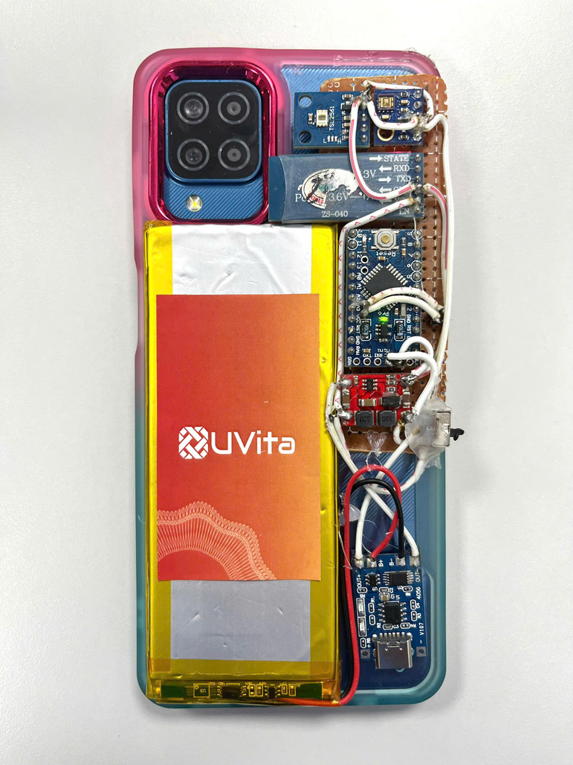

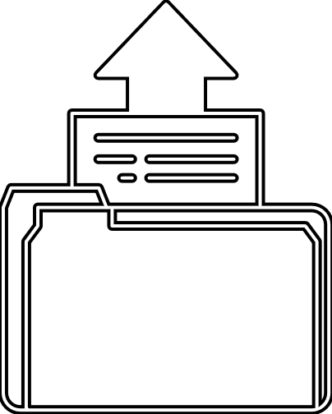
OUR SOLUTION
PHONE CASE DEMO
UVita APP

Slide 7
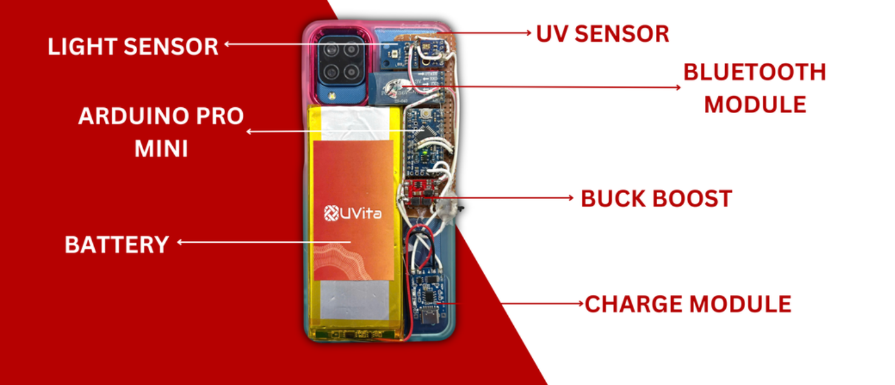
HOW DOES IT WORK?
UVita's system uses a UV-sensing phone case with integrated sensors to detect and transmit real-time UV data to the mobile app.

Slide 8
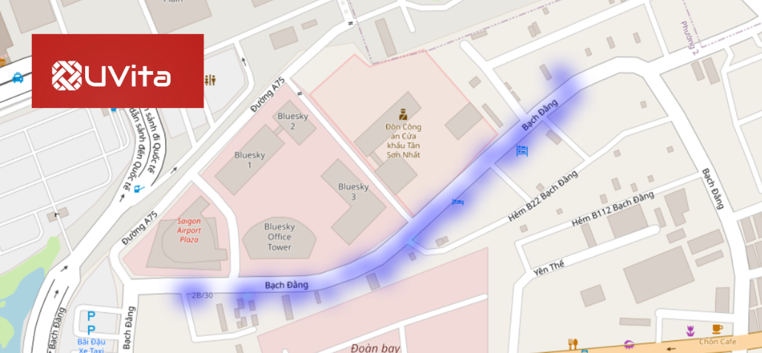
UVITA MAPPING
UVita enhances public understanding of UV radiation risks by providing real-time data, promoting sun safety to reduce skin damage and cancer, while encouraging responsible sun exposure habits.

Slide 9
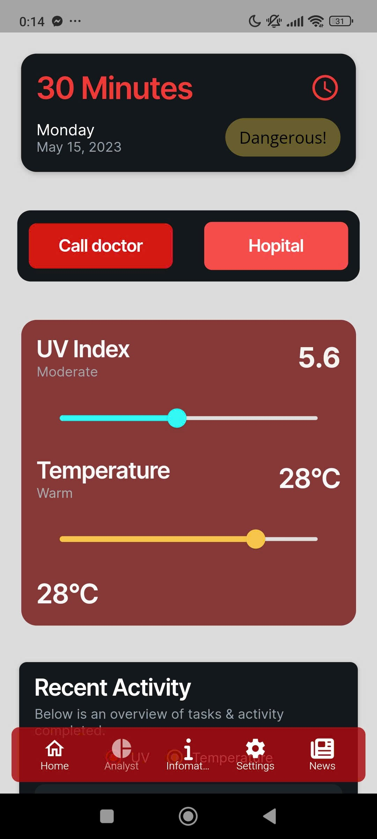
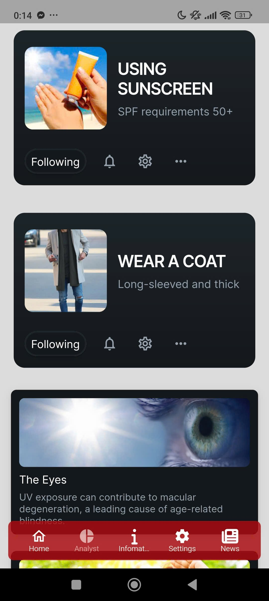
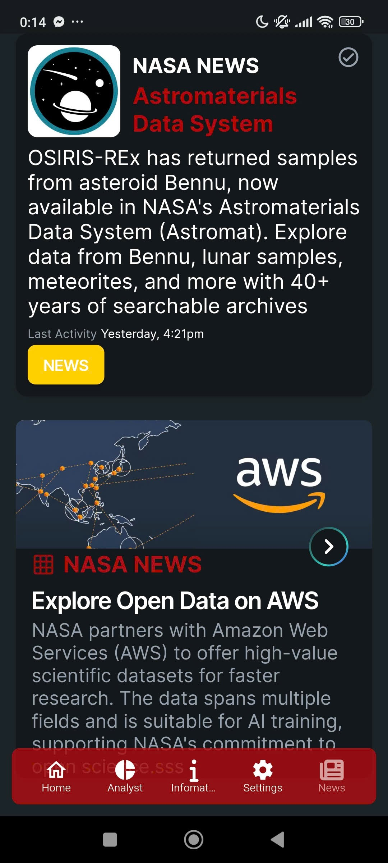
OUR APPLICATION
Real-time UV alerts empower users to make informed sun safety decisions.
UVita educates users about UV risks, promoting skin health awareness.
Daily scientific updates.

Slide 10
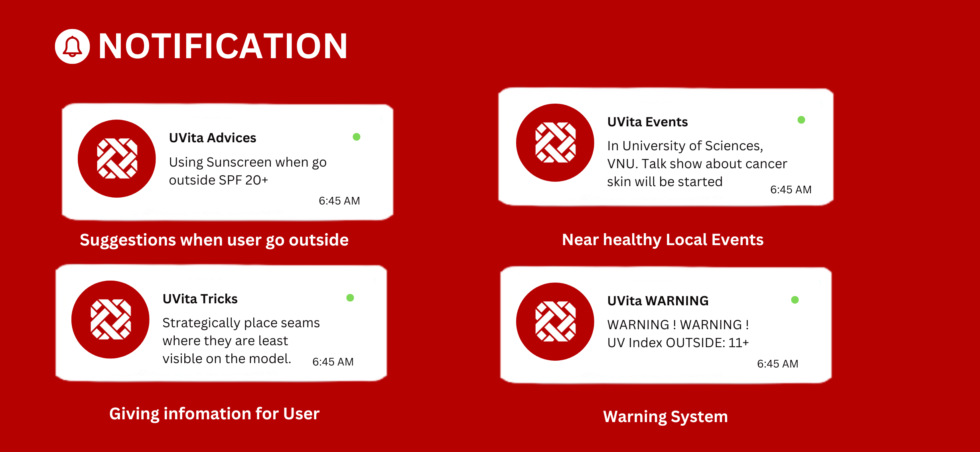
OUR APPLICATION
Uvita’s notification interface on the phone screen.

Slide 11
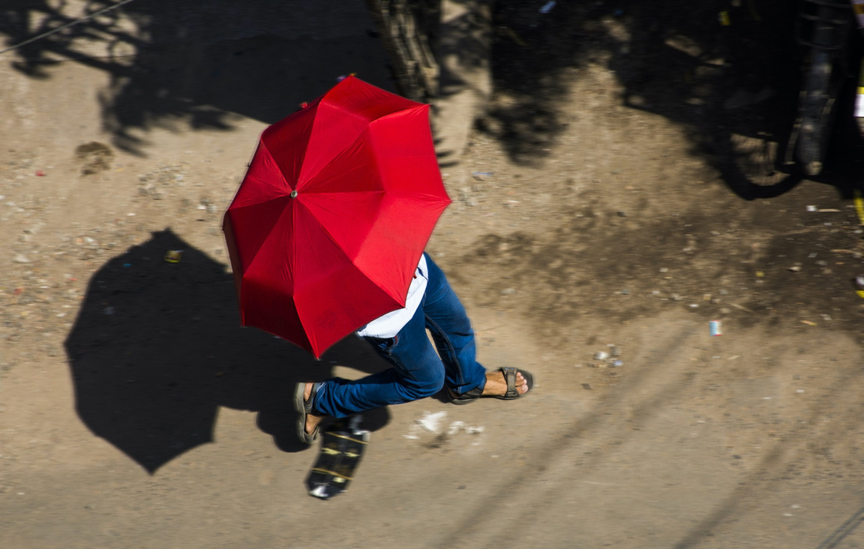
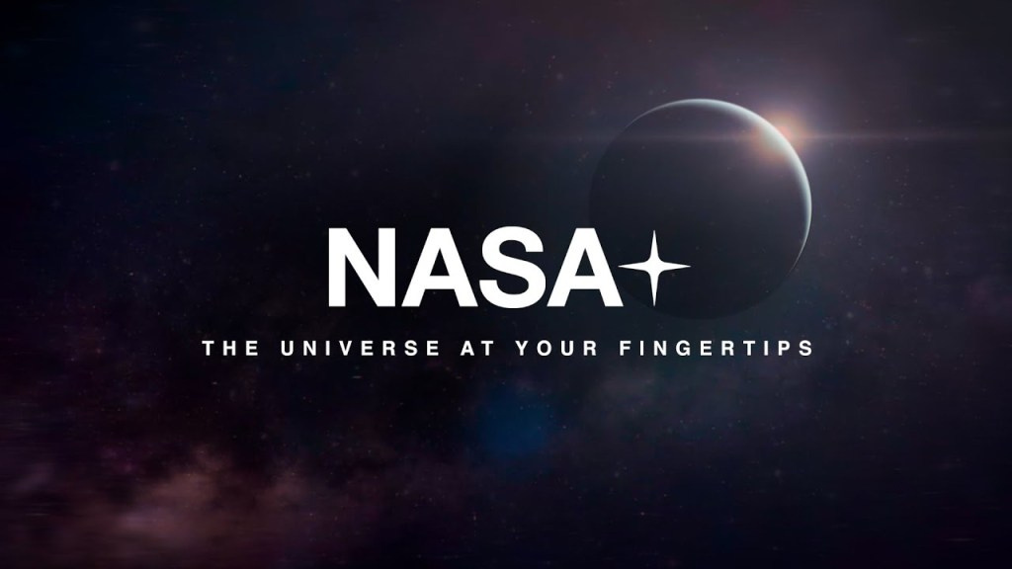
THE MAIN IMPACT OF UVITA
“RAISE awareness – CULTIVATE good habits.”
for limit and prevent health-related issues, especially those caused by UV rays.
PROVIDE databases for:
NASA - National Aeronautics and Space Administration.
research organizations.
schools, universities, companies, etc.
PROVIDE a Marketplace for skincare/healthcare products

Slide 12
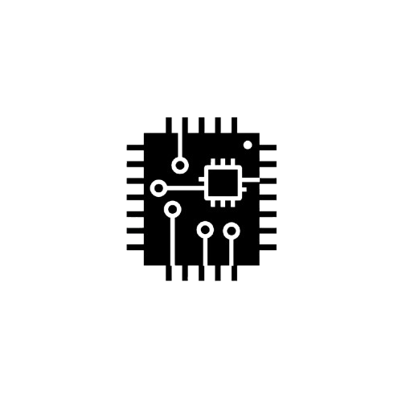


CONCLUSION
1
Creating UV sensor phone case – Transfer data to a mobile app by Bluetooth.
2
Developing new UV index map on UVIta.
3
Providing health solutions, personalize UV data for users and construct a ground – level UV measurement dataset.

Slide 13
FUTURE WORK
Improving the phone case to be user-friendly.
Build a sales system based on advice for users.
Using Machine learning to analyze reponse data.
The map shows the locations of health centers.
Supporting health by providing indicators (temperature, define dust, etc.)

Slide 14
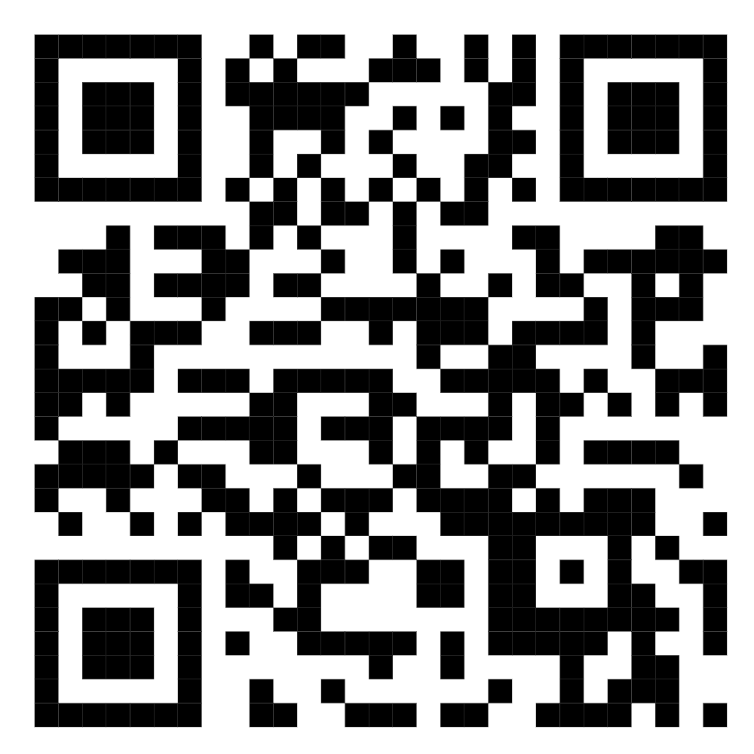
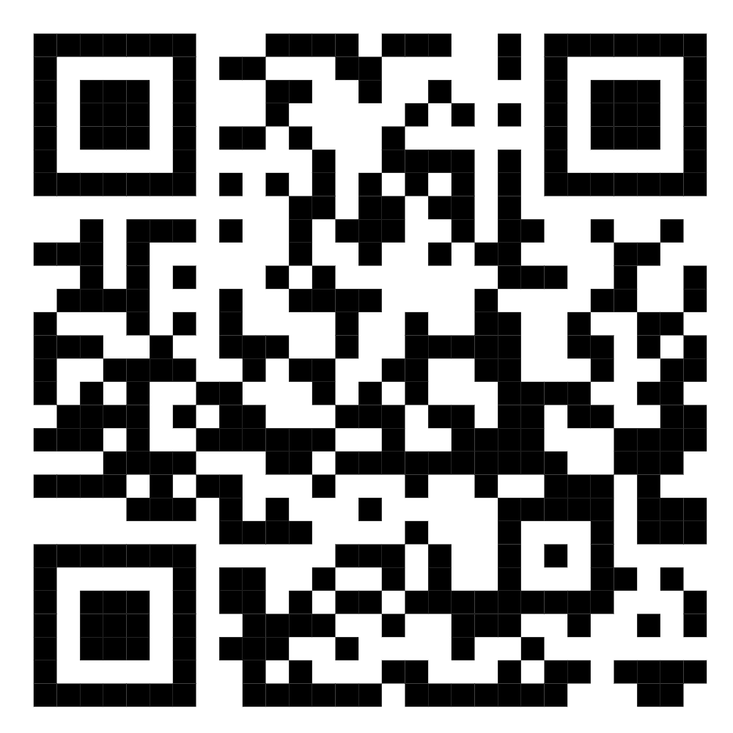
REFERENCES
DATA SOURCES AND REFERENCES.
PHO BROTH’S PROJECT ON NASA SPACE APP CHALLENGE 2024.

Slide 15

THANK YOU.

